Slide 1



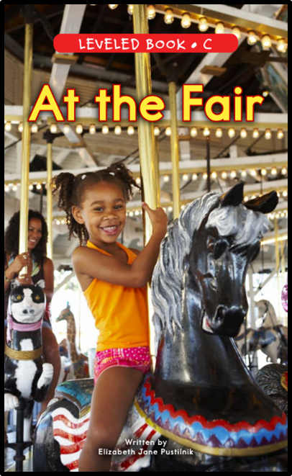

Sentence Pattern
Let’s have a closer look at some sentences!

Slide 2
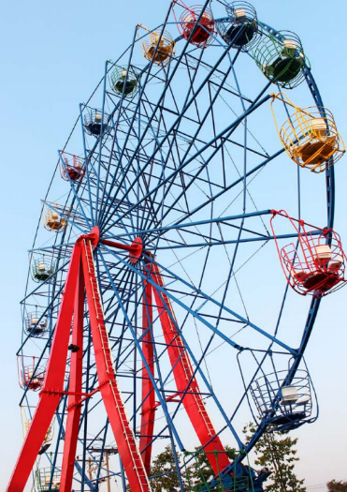
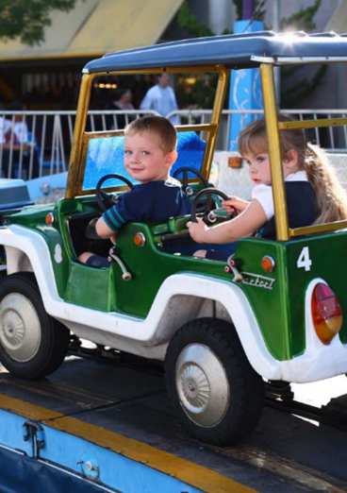


Sentence Pattern
What is missing?
You can ride the big .
You can ride the little car.
wheel

Slide 3
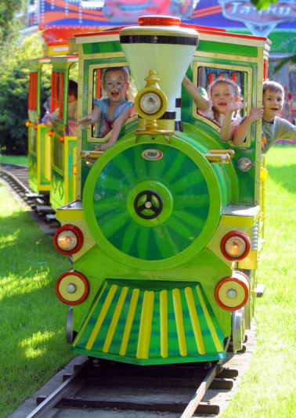
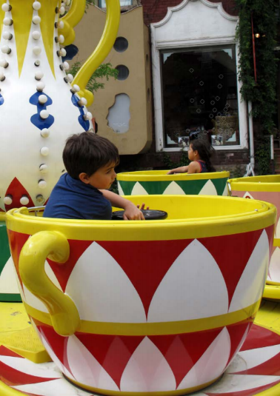
Sentence Pattern
What is missing?
You can ride the long train.
You can ride the fast cup.

Slide 4
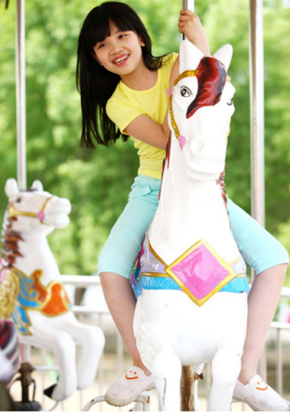
Sentence Pattern
What is missing?
You can ride the
You can ride the
giant
painted
horse.
swing.

Slide 5
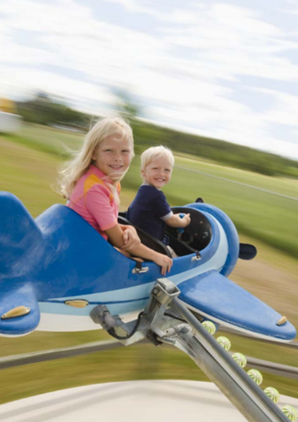
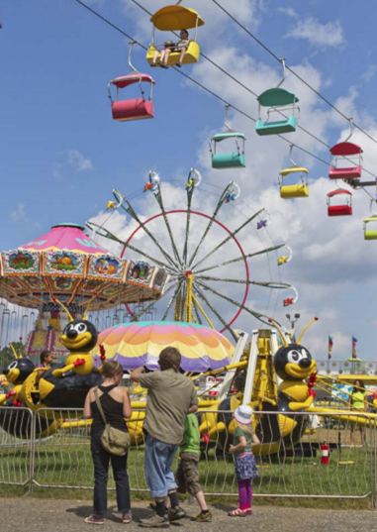
Sentence Pattern
What is missing?
You can ride the
What is your
favorite
fair
tiny
plane
ride at the .

